Slide 1

Integrating scRNA-seq and QSP Modeling to Investigate CAR-T Resistance in Multiple Myeloma
A Systems Immunology Case Study

Slide 2

Background
BCMA-targeted CAR-T
Effective therapy for multiple myeloma patients
Clinical Challenge
Relapse and resistance common after initial response
Key Questions
Why do tumors relapse post-treatment?
T Cell Mystery
Low T cell presence in post-treatment samples

Slide 3
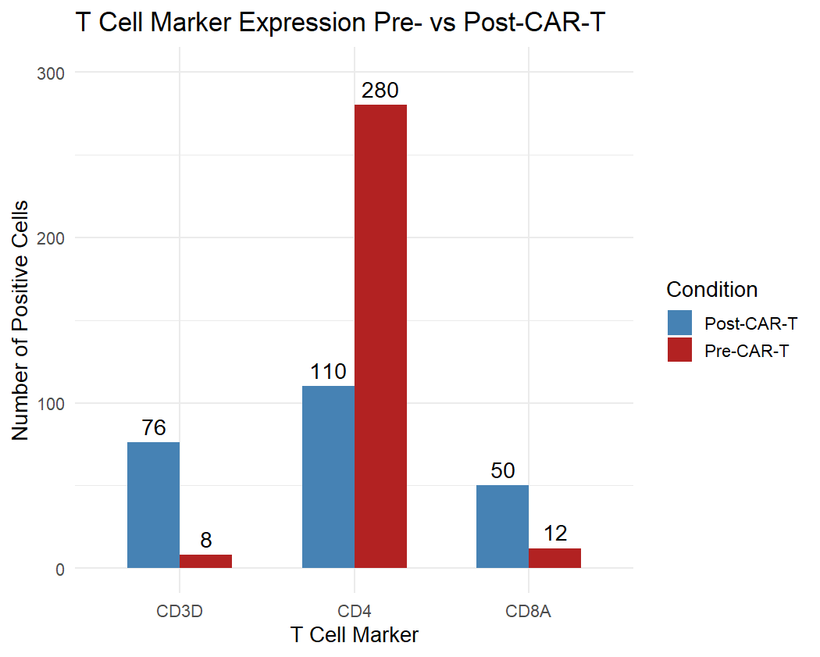
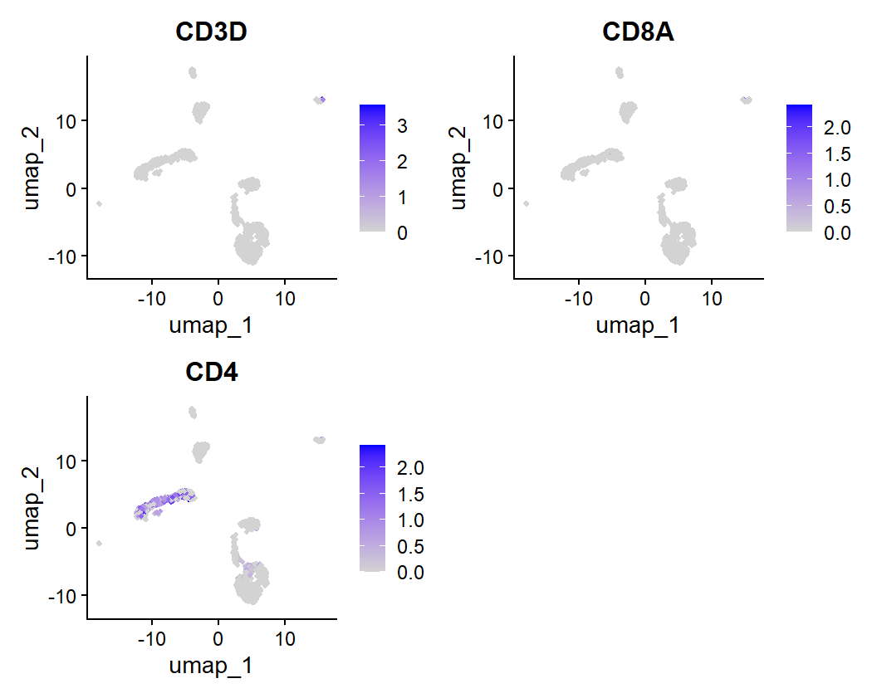
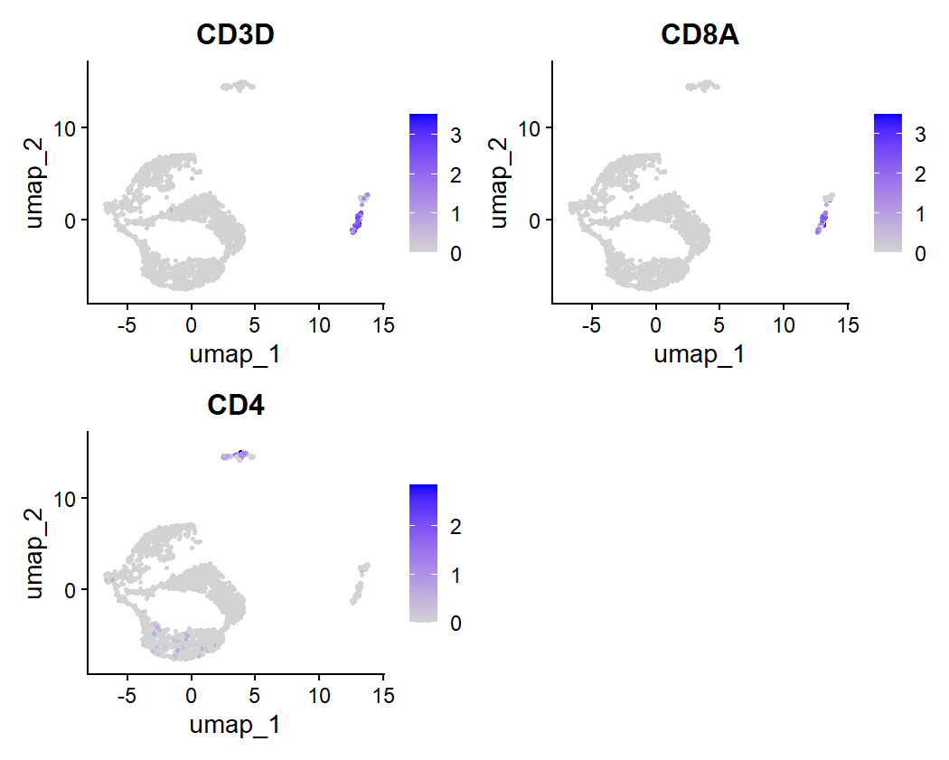
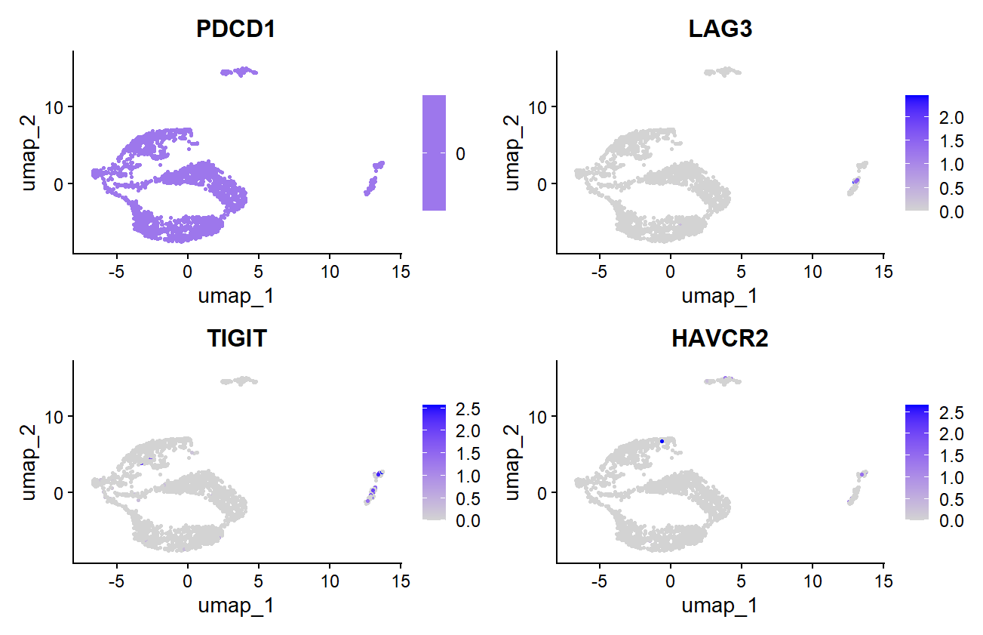
scRNA-seq Data Insight (T Cells)
Pre-Treatment
Post-Treatment
Strong CD3D, CD4, CD8A expression
Significant marker downregulation
Robust T cell population
Sharp T cell population decline

Slide 4
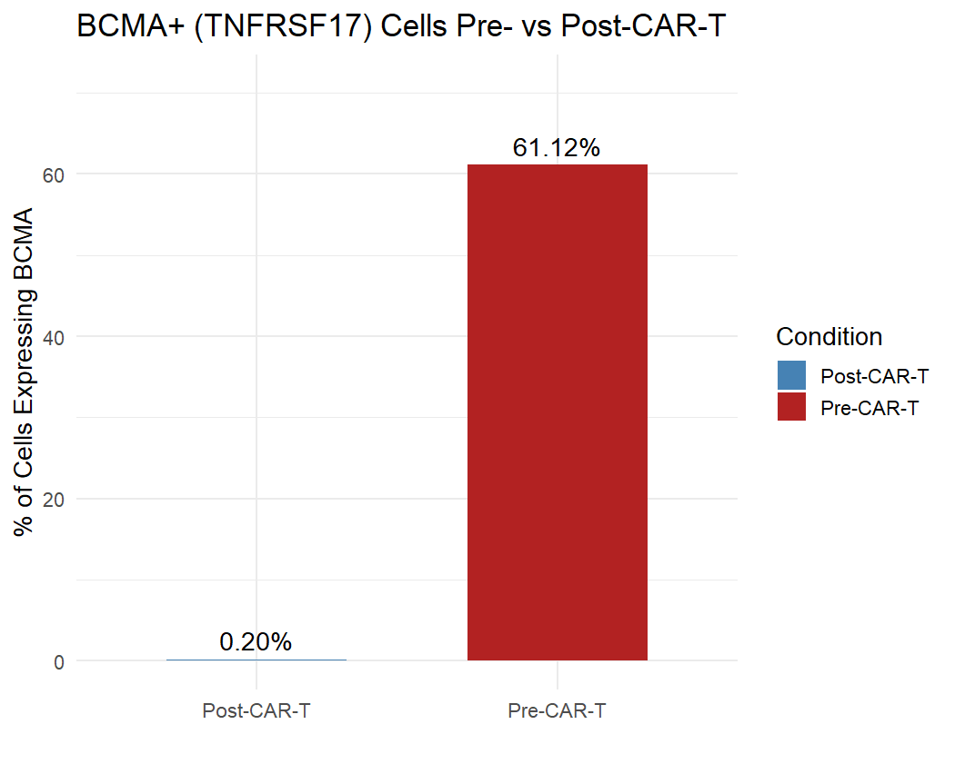
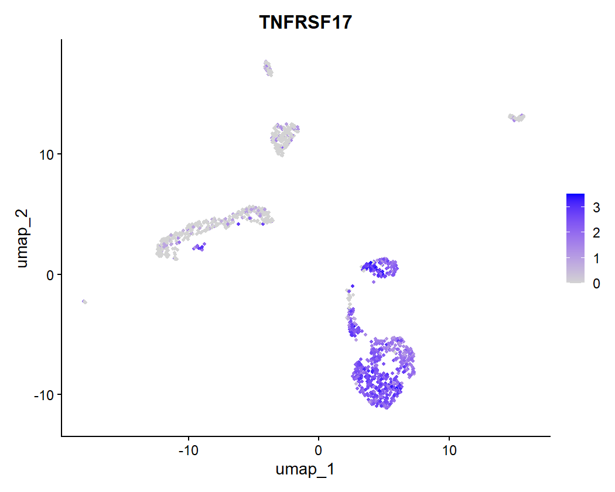
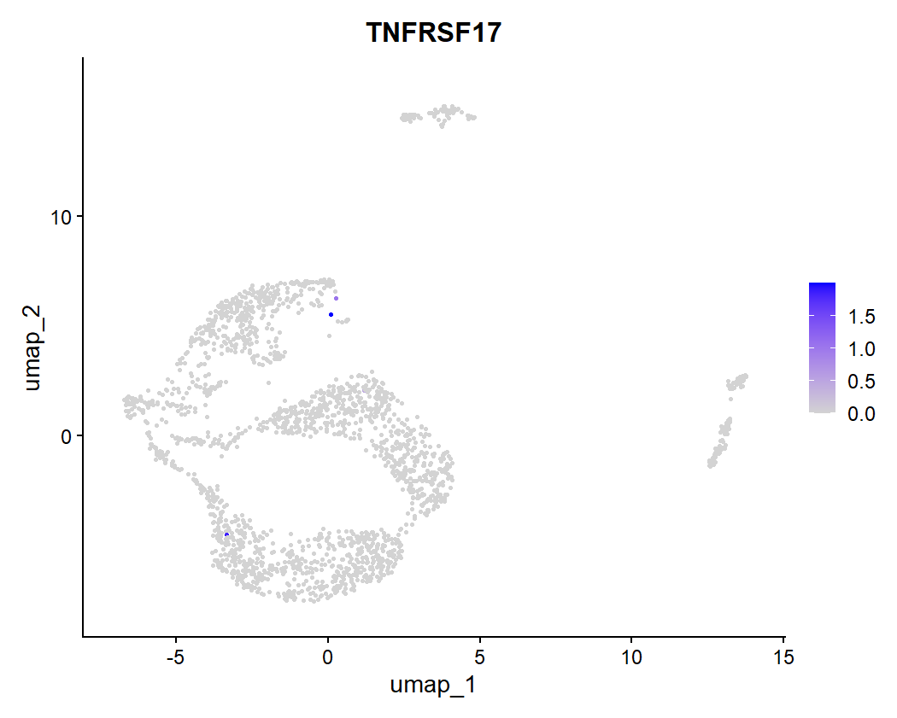
scRNA-seq Insight (BCMA+ Tumor)
61.12%
0.2%
Pre-Treatment
Post-Treatment
TNFRSF17 (BCMA) expression
BCMA expression nearly eliminated

Slide 5
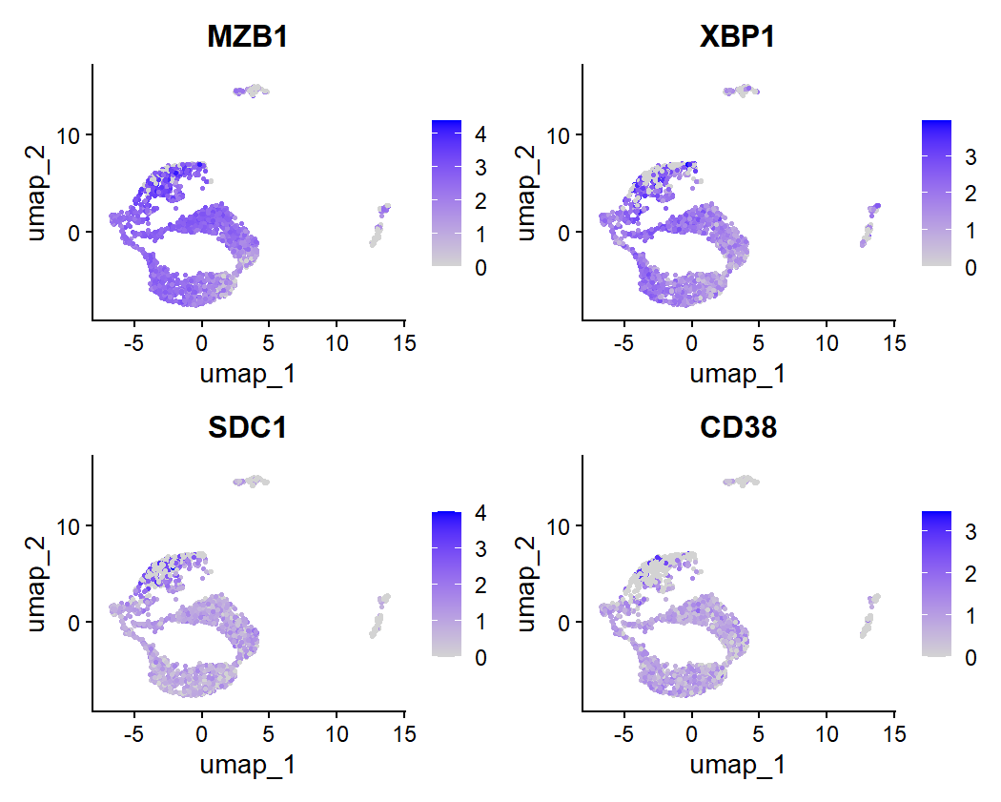
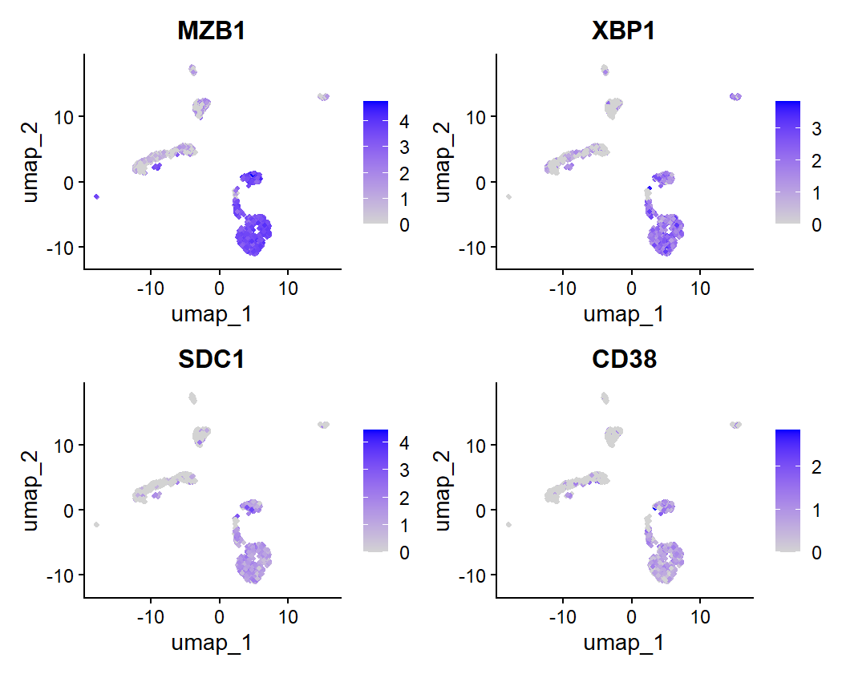
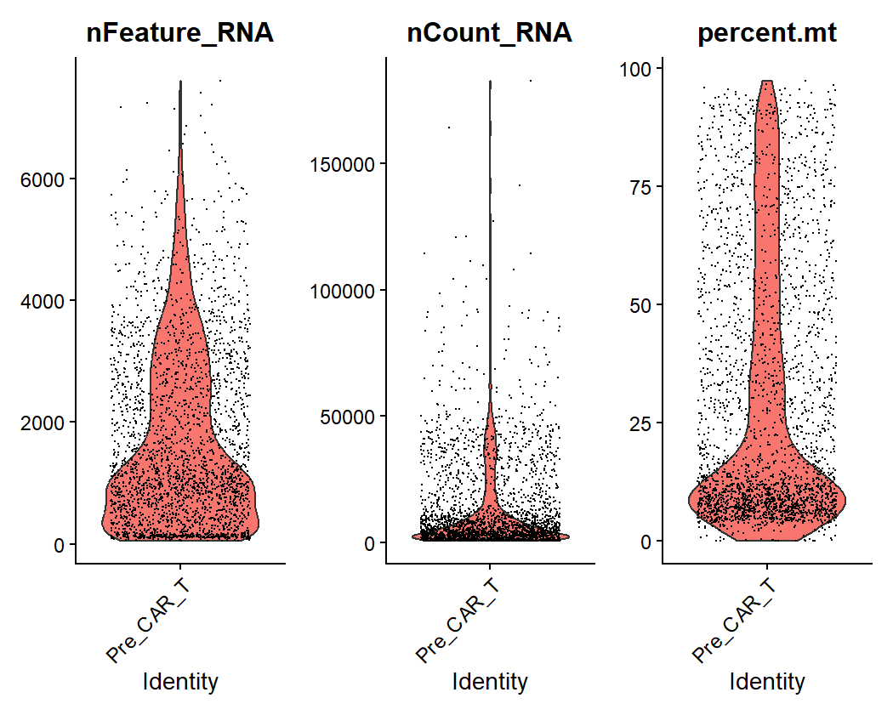
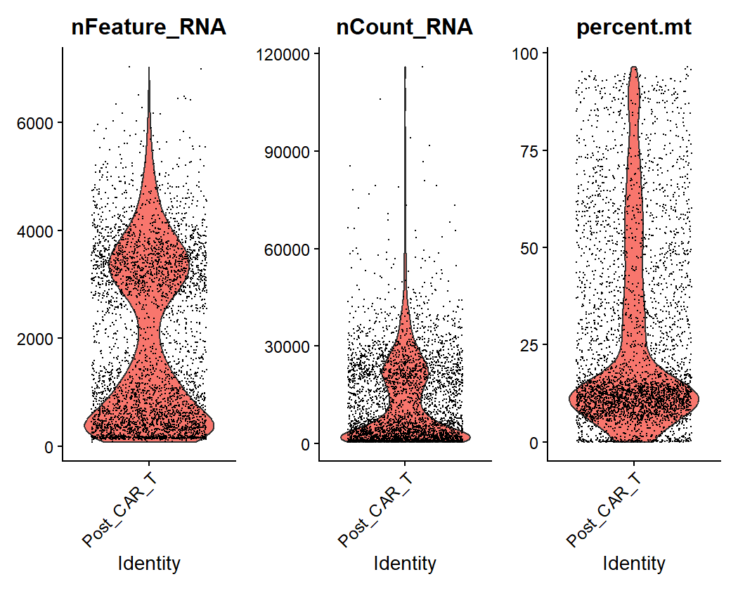
Plasma Cell Marker UMAPs
Pre-Treatment
Post-Treatment
Distinct plasma cell populations
Dramatic reduction in marker expression

Slide 6






Modeling Hypothesis
Paradox
Tumor depletion with low T cells
Hypothesis
Early CAR-T action followed by exhaustion
Mechanism
Cytotoxic effect persists after T cell depletion

Slide 7






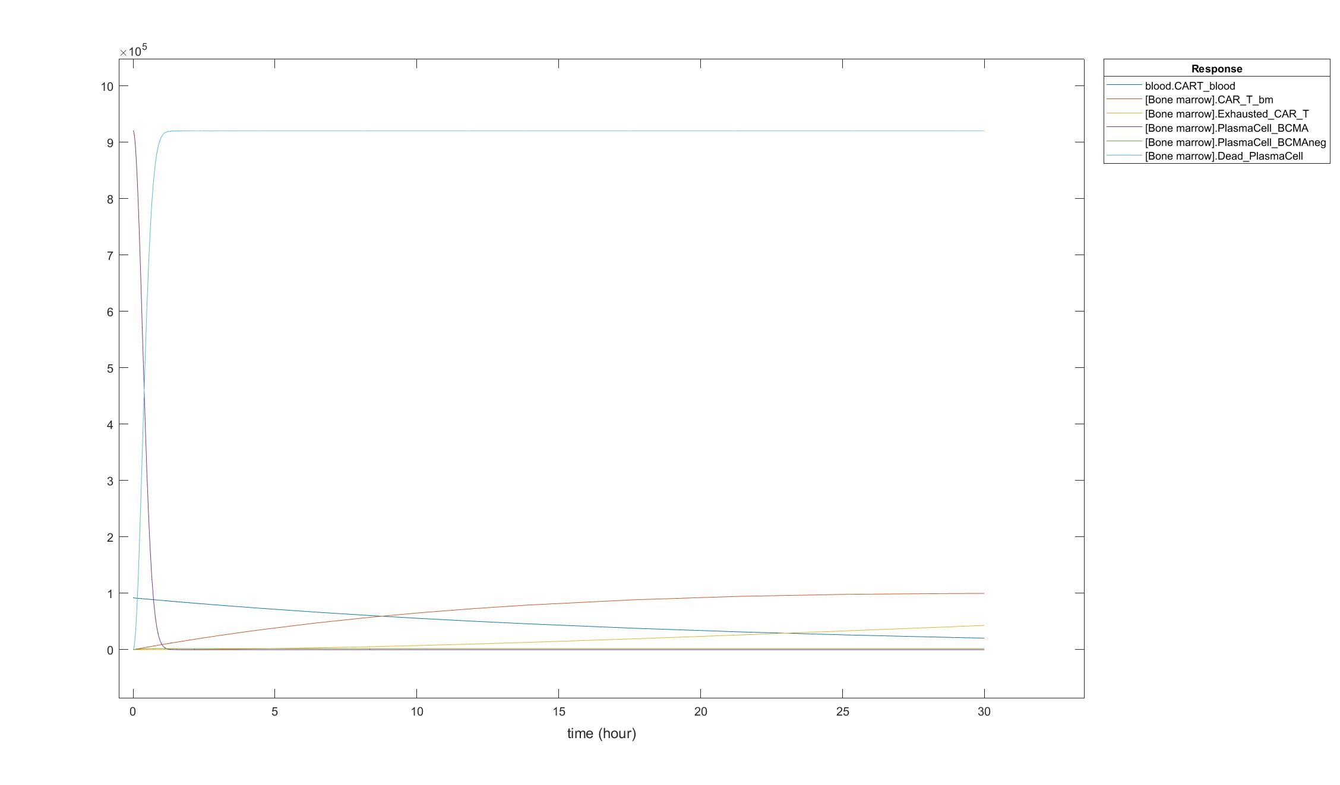


SimBiology QSP Model Setup
Cell Types
Compartments
CAR-T, Exhausted CAR-T, BCMA+/- Plasma Cells
Bone Marrow, Blood
Cell counts, AUC,
depletion metrics
Outputs
Parameters
k_kill, k_growth, k_exhaustion,
k_escape

Slide 8
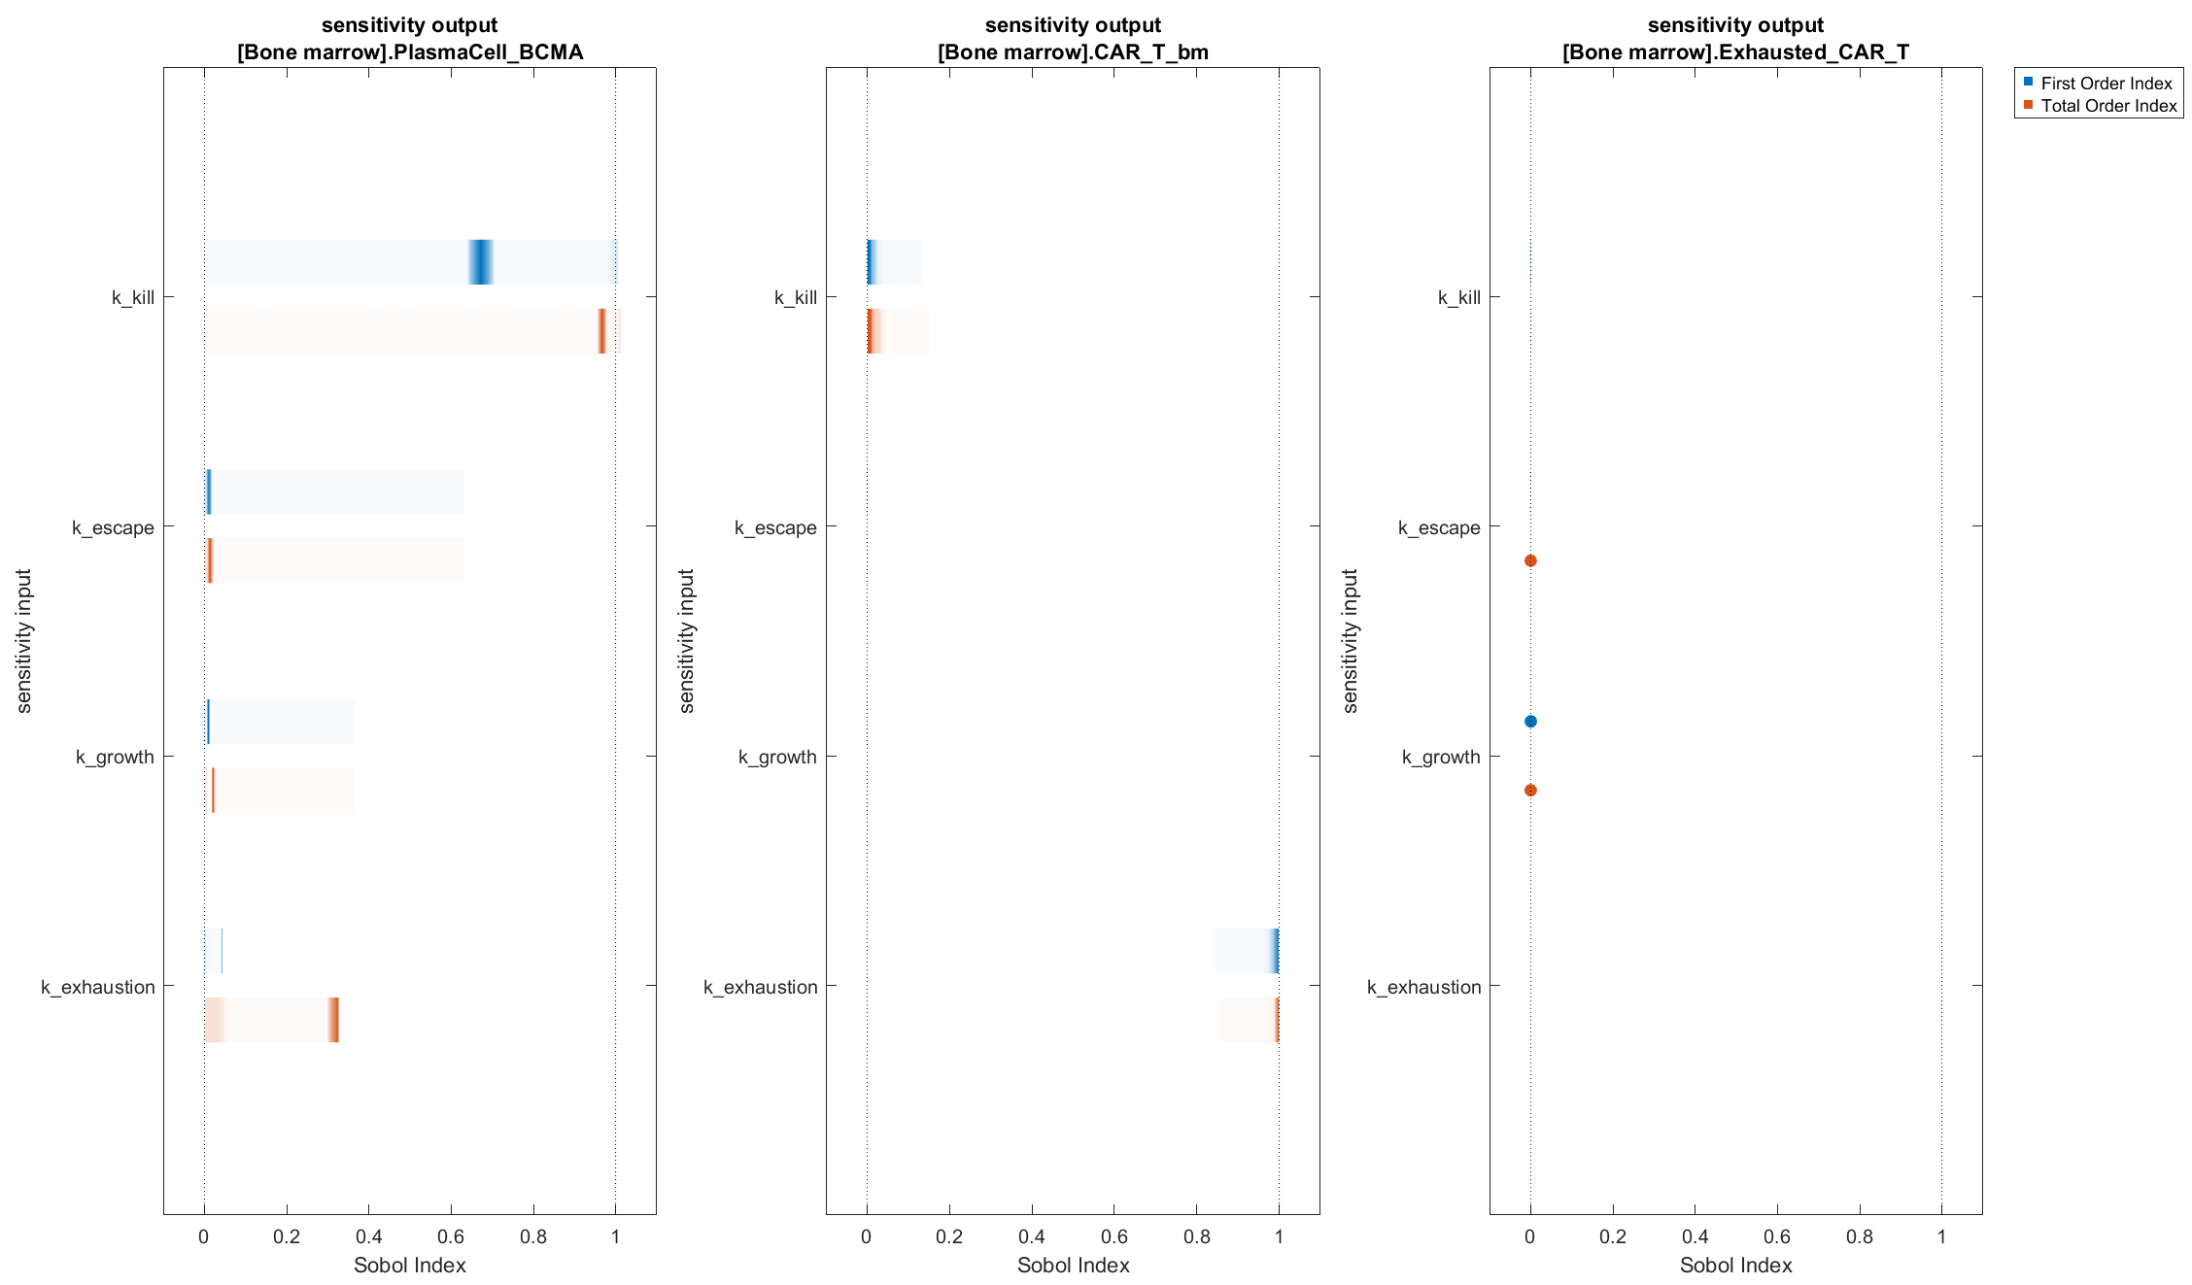
Sensitivity Analysis (Key Outputs)
Tumor (BCMA+) Depletion
CAR-T AUC
Primarily affected by k_exhaustion
k_kill, k_escape primary drivers
Exhausted CAR-T Accumulation
Balance between k_exhaustion and elimination rate

Slide 9
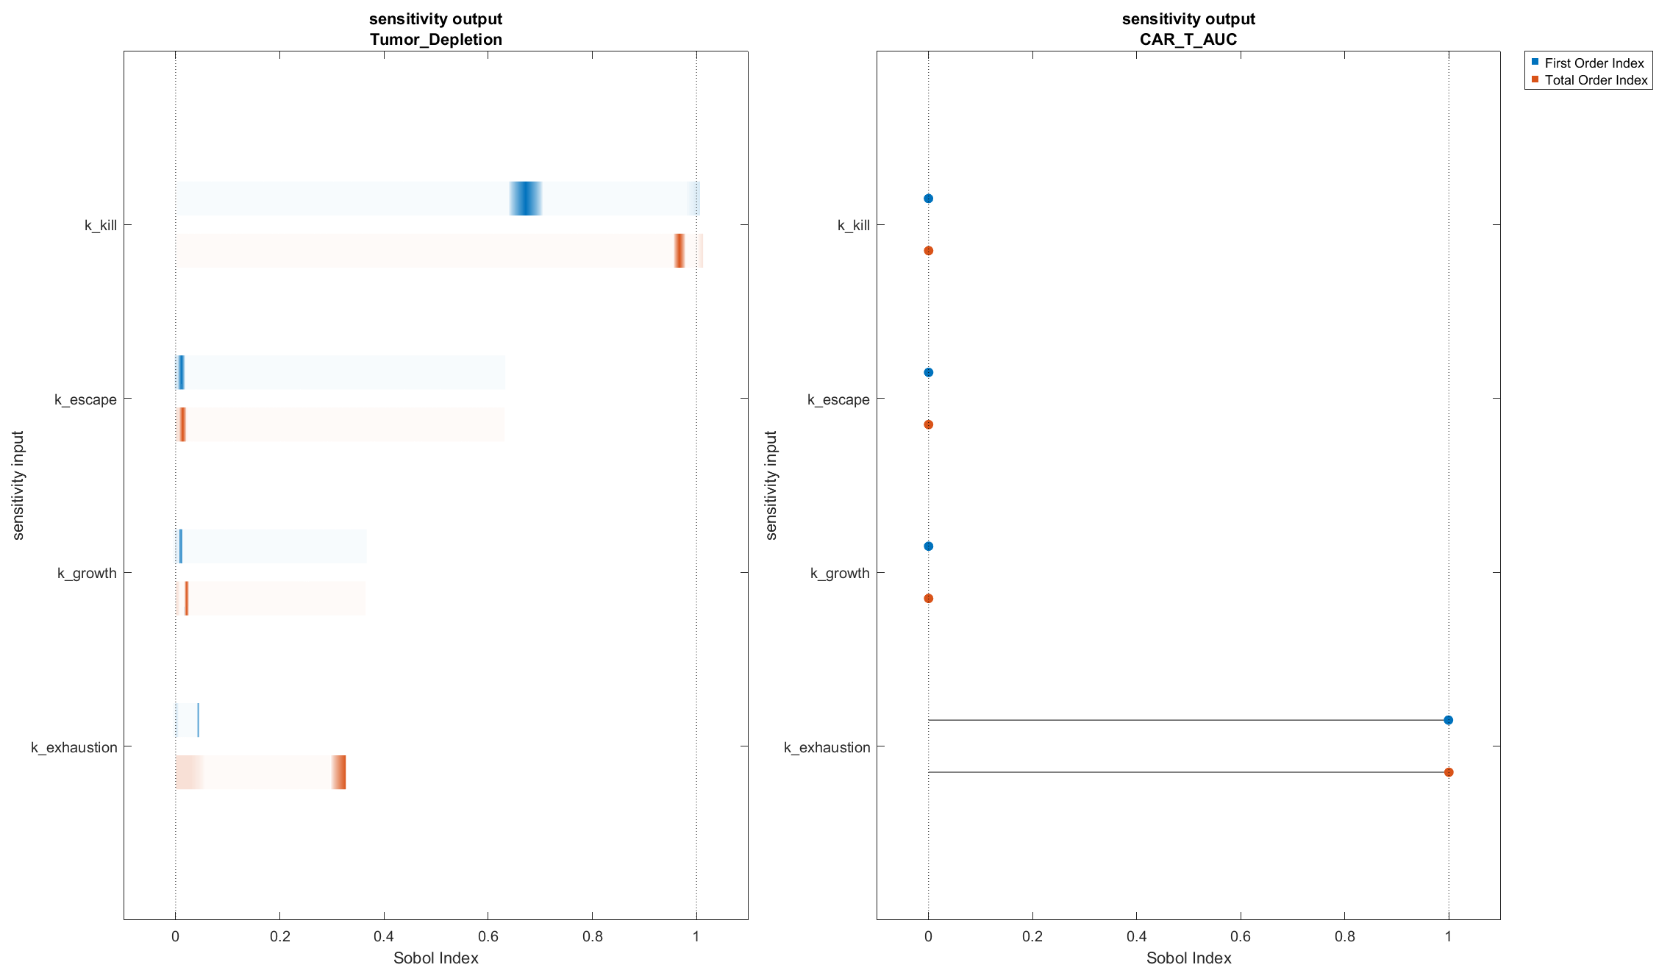



Tumor Depletion vs CAR-T AUC
Tumor Depletion
Depends on k_kill, k_exhaustion, k_escape
CAR-T AUC
Almost entirely depends on k_exhaustion
Relationship
Partial independence between metrics

Slide 10
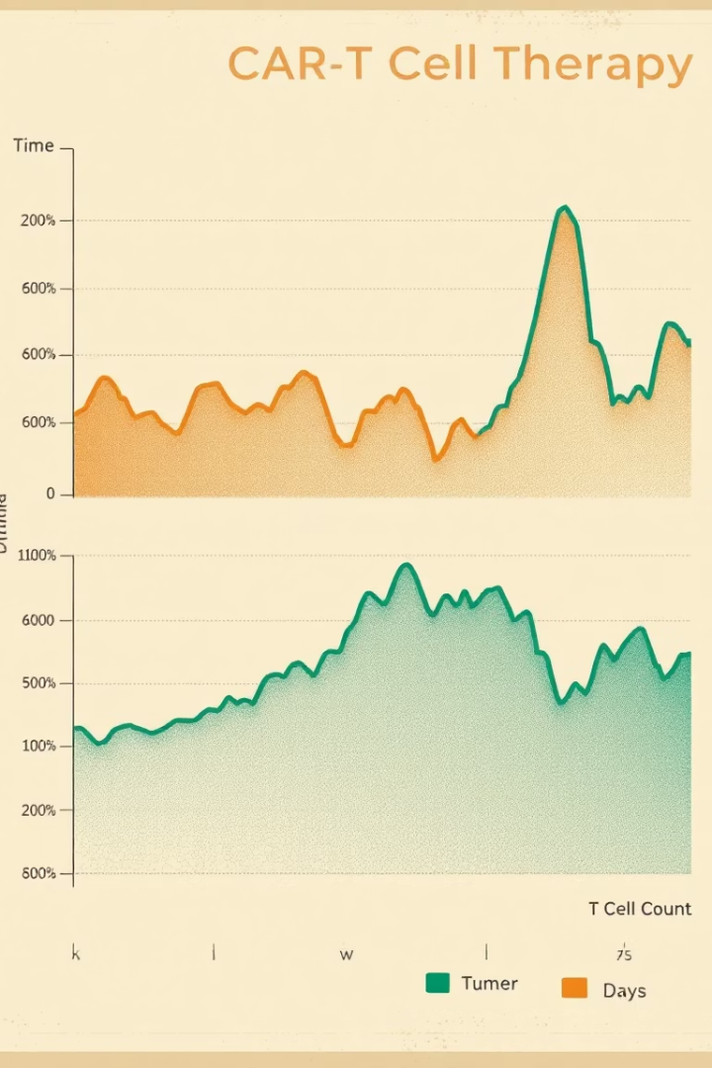



Observables and Interpretation
Tumor_MinTime = 2.2 hrs
Rapid initial tumor killing
CAR_T_PeakTime = 30 hrs
Much later than tumor effects
CAR-T Exhaustion
Likely occurs by expansion peak
Maximum tumor kill is achieved within ~2 hours post-therapy, while CAR-T expansion peaks around 30 hours, indicating early cytolytic efficiency followed by potential delayed proliferative or memory responses.

Slide 11
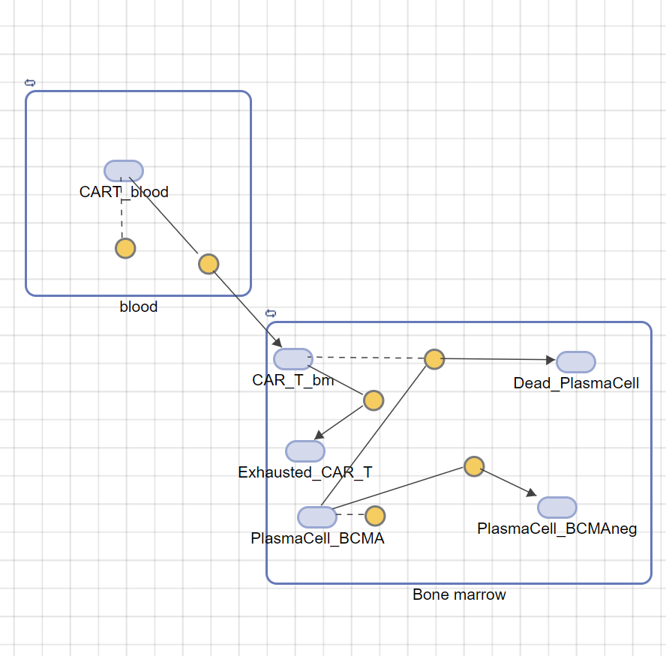
Summary & Conclusion
CAR-T kills BCMA+ tumor early, then exhausts
Bioinformatics + QSP both suggest T cell exhaustion as key resistance node
Sensitivity analysis pinpoints actionable parameters (k_kill, k_exhaustion)
Modeling guides new interventions: checkpoint inhibitors or cytokine support
Acknowledgments
Data: Lee et al., Nat Med 2023
Tools: MATLAB SimBiology, Seurat (R)

